Slide 1

BoH – Bank of Happiness
Bank Management System
Zohaib Azam – 22732
Umme Labib Asif – 21749
Shariq Anwar – 22736

Slide 2

FACILITIES
Admin Panel
User Facility
Complain Box

Slide 3
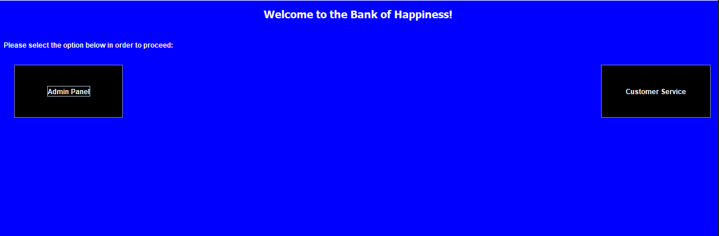

Slide 4
Admin Panel
Features:
Create Account
Delete Account
Account Details
Show All Accounts
Logs of Account

Slide 5
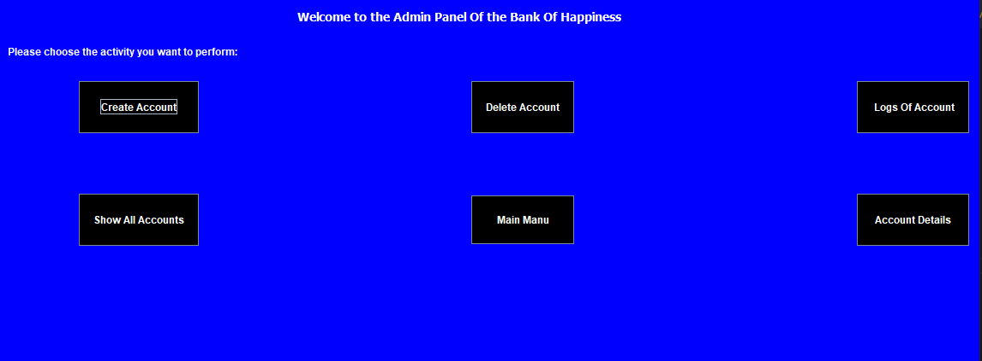
PIC OF ADMIN PANEL

Slide 6


User Facility
Features:
Cash Deposit
Cash Withdraw

Slide 7
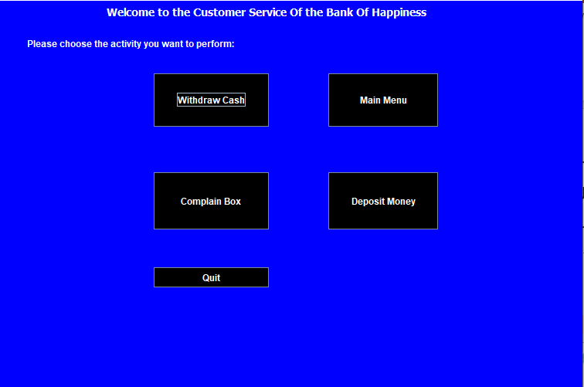
PIC OF USER PANEL

Slide 8

Complains
Features:
Complain Box

Slide 9
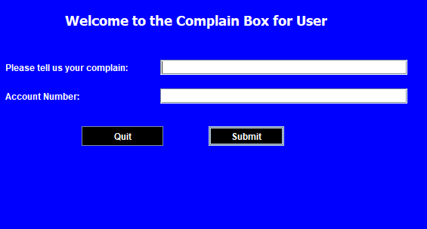
PIC OF COMPLAIN BOX PART

Slide 10
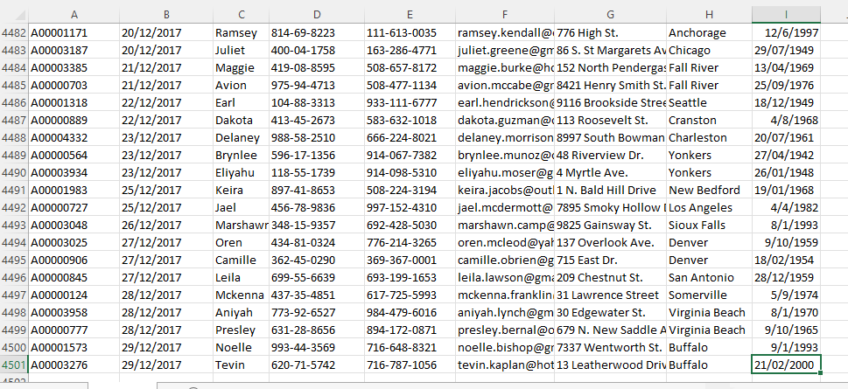
Sample data from the file used for accounting records

Slide 11
Coding Review:
Data Structures:
BIG Os:
Array – Storing Accounts’ records
Hashing done on Accounting ID
LinkedList – Containing references/indexes of the Transactional Records’ array
accounts
Operations | BigO
Insert | O(1) / O(R) for collisions – R = no of times rehashed
Search | O(1) / O(T) for Transactions where T is the no of Transactions for Account – whose index is accessed through LinkedList
Delete | O(1) / O(R) for collisions – R = no of times rehashed

Slide 12
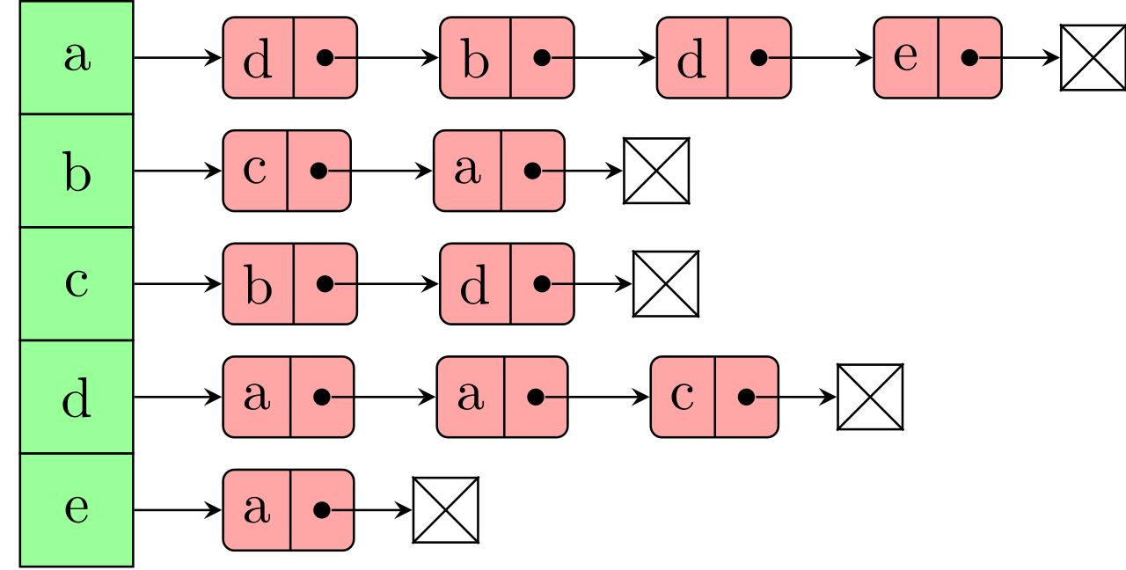
Representation of Data Structure Used in
accounts

Slide 13
Code Description:
Code to store the account details of customers
Array is of Account Node data type - AccountNode class contains an instance variable data which stores the record of the struct AccountType via parameter in the constructor.
Methods:
Insert (to add new Account)
Deactivate (to remove an Account),
Search (to search for Account Details/Account related Transactions),
ToString (to display the Details of the searched account)
Hashing methods
accounts

Slide 14
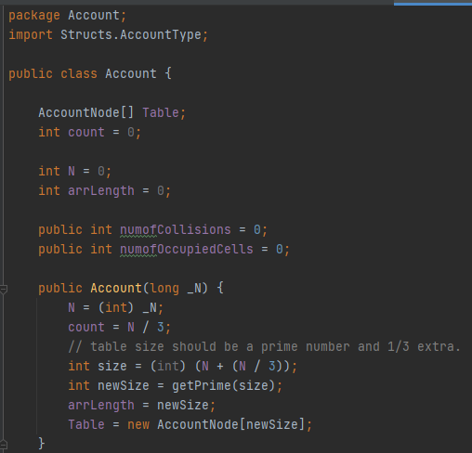
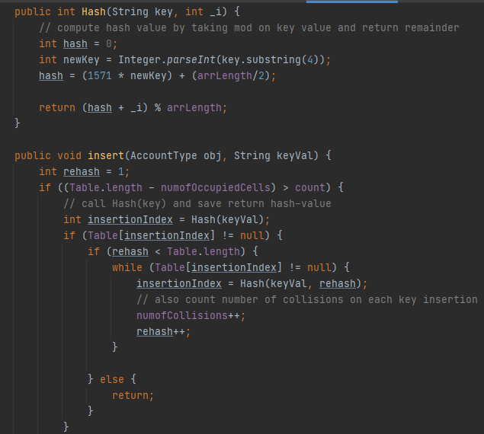

Slide 15
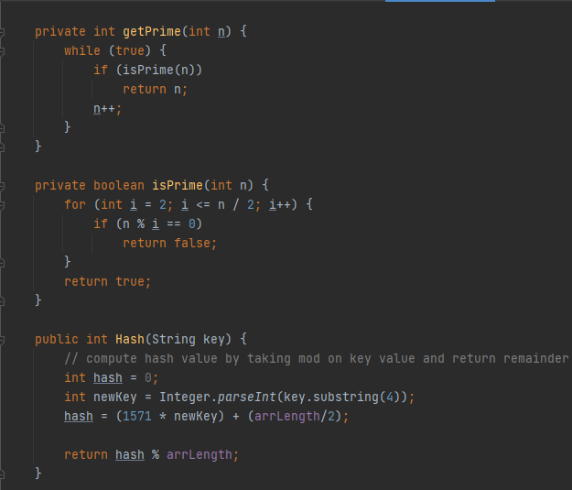

Slide 16
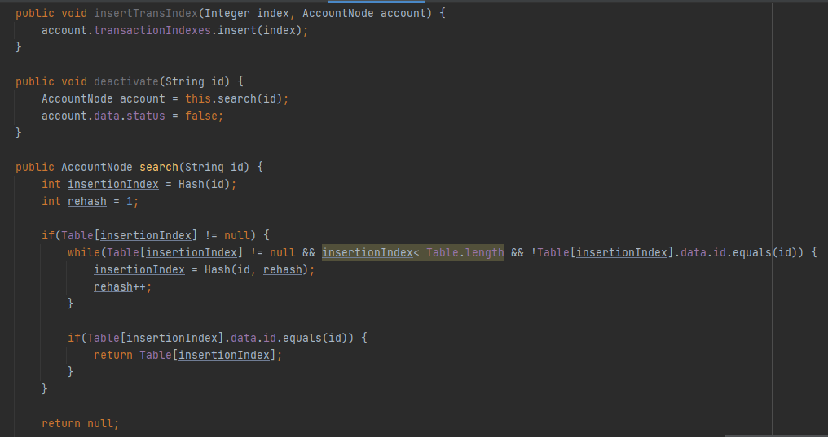

Slide 17
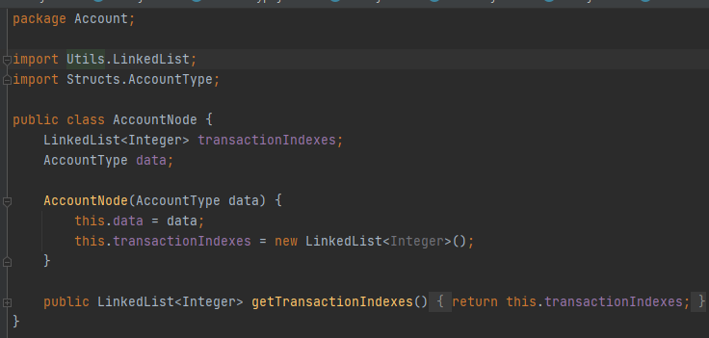

Slide 18
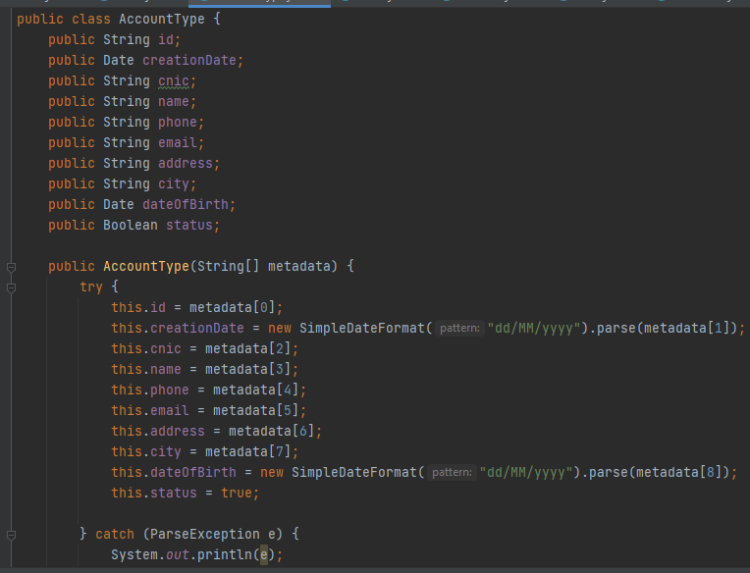

Slide 19
Hash function for accounts
public int Hash(String key, int _i) { // compute hash value by taking mod on key value and return remainder int hash = 0; int newKey = Integer.parseInt(key.substring(4)); hash = (1571 * newKey) + (arrLength/2); return (hash + _i) % arrLength;
<20 % collision on data set of 5k+

Slide 20
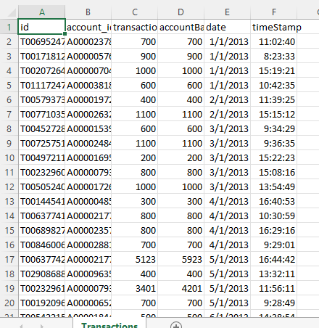
Sample data from the file used for transactional records

Slide 21
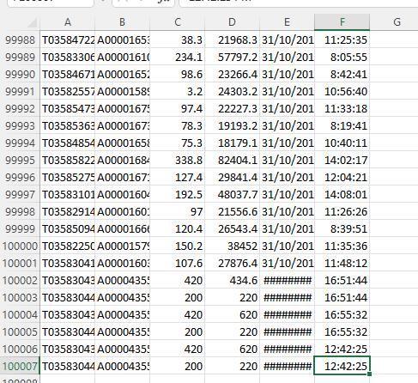
Sample data from the file used for transactional records

Slide 22
Coding Review:
Data Structures:
BIG Os:
Array – Storing Transactions of the Accounts
Hashing done on Transaction ID
TRANSACTIONS
Operations | BigO
Insert | O(1) / O(R) for collisions – R = no of times rehashed
Search | O(1)
Delete | O(1) / O(R) for collisions – R = no of times rehashed

Slide 23
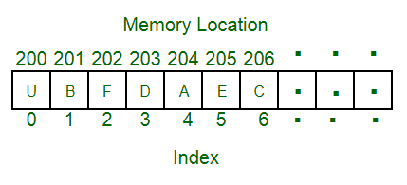
Representation of Data Structure Used in
transactions

Slide 24
Code Description:
Code to store the transactions of users’ accounts
Array is of Transaction Type struct data type - Transaction Type Struct contains variables which stores data from the Transaction Record files (sample shown above)
Methods:
Insert (to add new Transaction)
Search (to search for Transactions)
ToString (to display the Details of the searched transaction)
Hashing methods
TRANSACTIONS

Slide 25
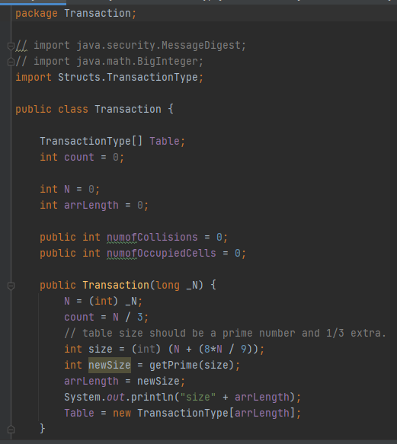
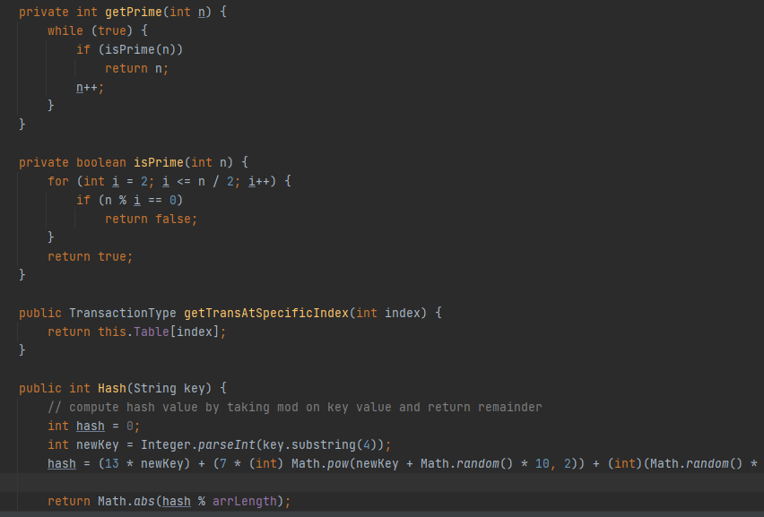

Slide 26
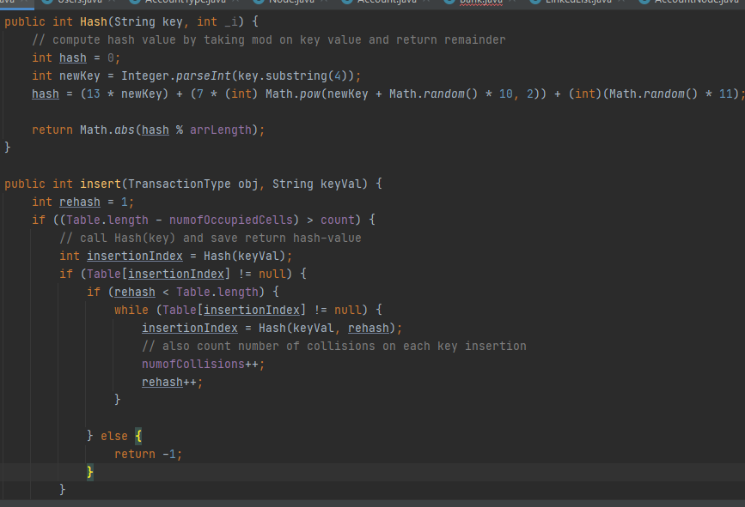

Slide 27
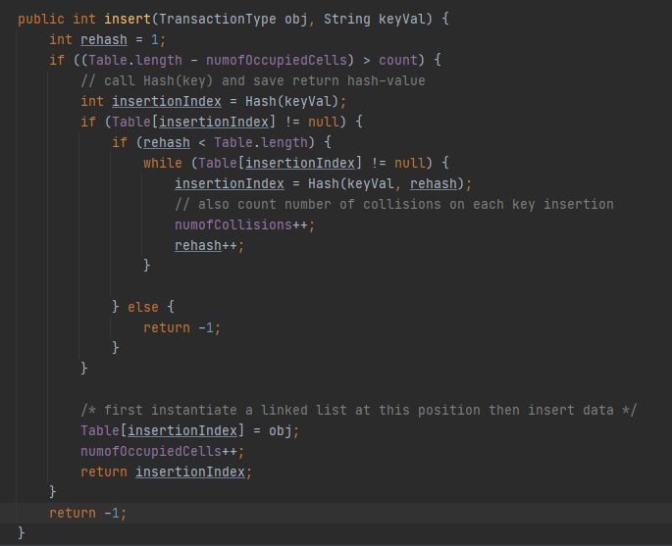

Slide 28
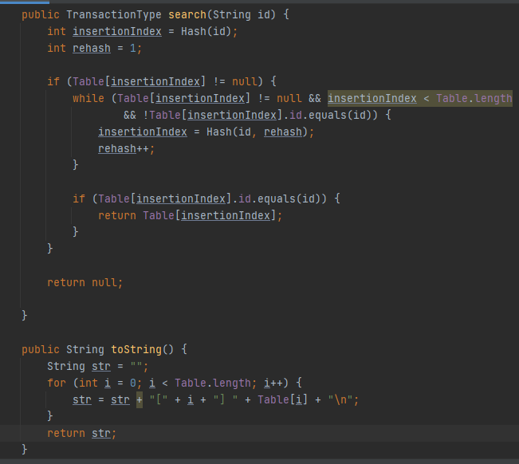

Slide 29
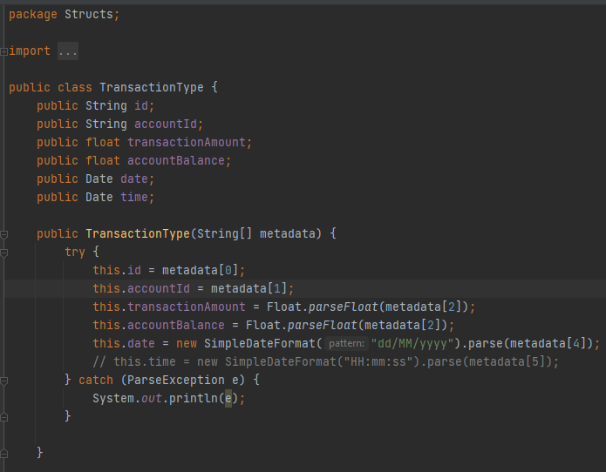

Slide 30
Code Description:
Code to link the GUI with Transaction and Account Class.
There is a getBank method which returns the instance of this class – called in GUIs to pass on the data entered by the user.
Methods:
Create Account (create Account based on information from parameter like name, cnic etc)
Delete Account (deactivate account based on the account number provided by User in the GUI)
Search Account (search Account based on the Account number provided by User in the GUI)
Show All Account
Deposit Amount
WithDraw Amount
Display Transaction Log of User (to search for Transactions through Acc No provided by the User)
Bank

Slide 31
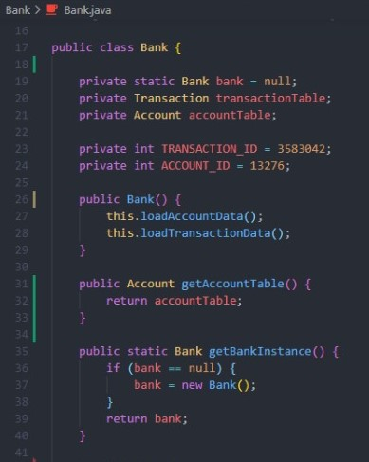
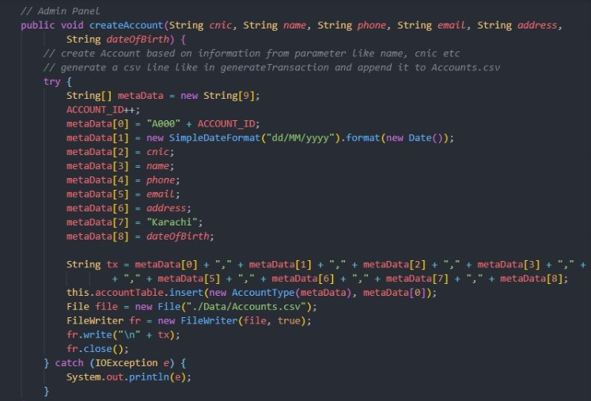

Slide 32
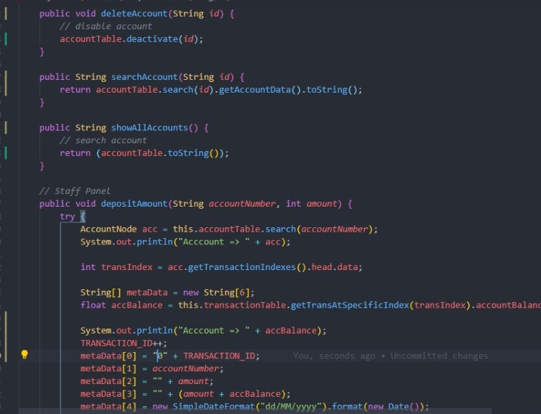
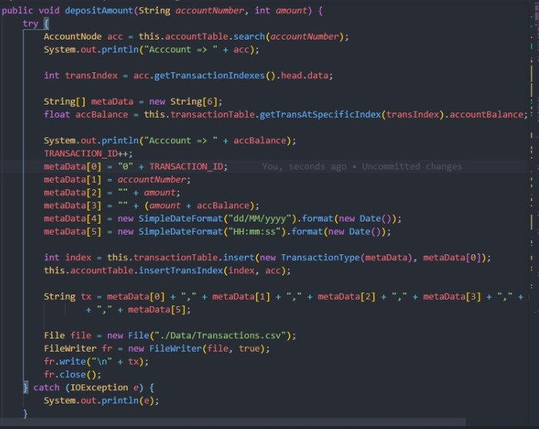

Slide 33
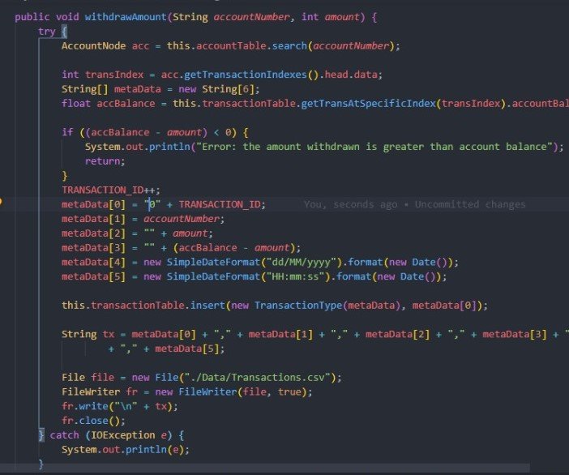
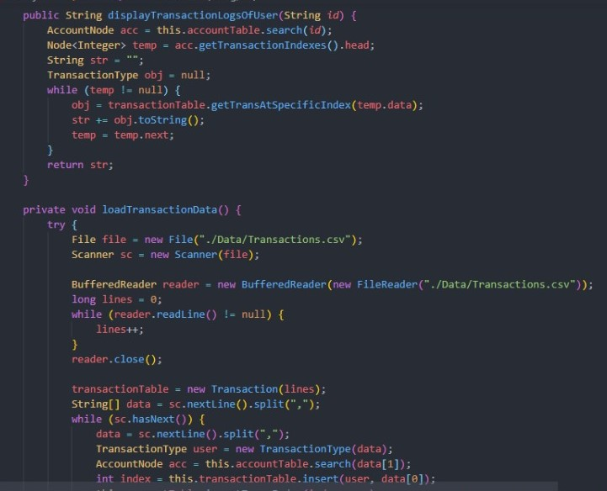

Slide 34
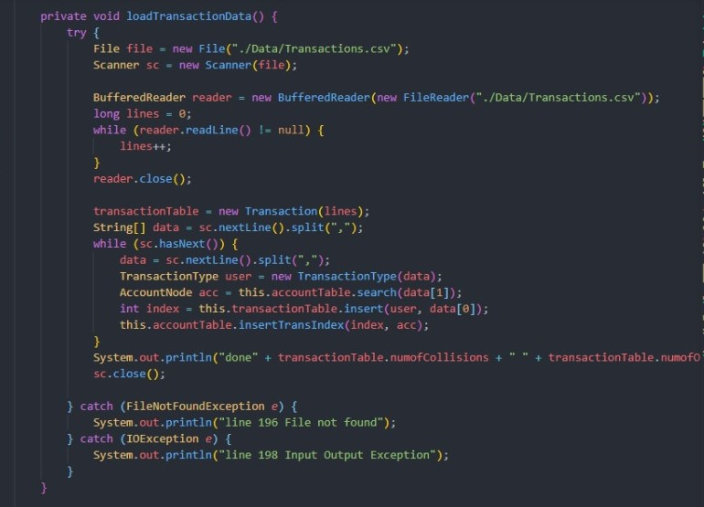
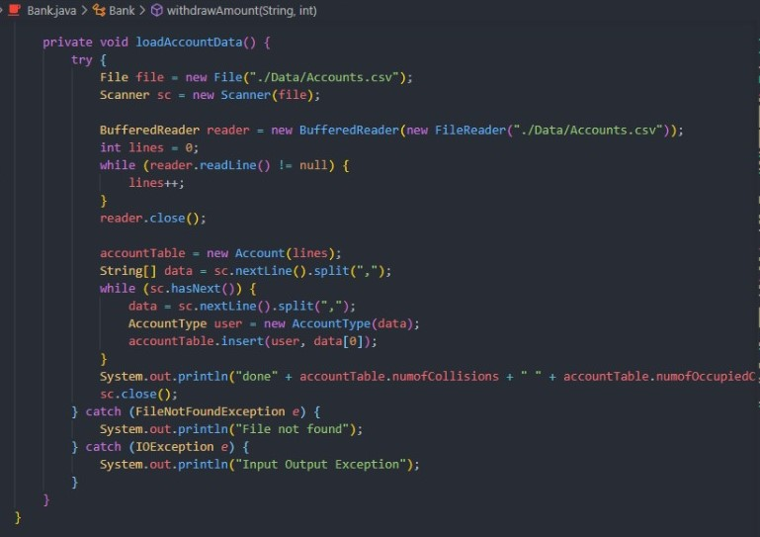

Slide 35
Coding Review:
Data Structures:
BIG Os:
LinkedList – Storing complains of the customers
Queue – For the first complain to be resolved first
Complain Box
Operations | BigO
Enqueue | O(1)
Dequeue | O(1)
isEmpty | O(1)

Slide 36
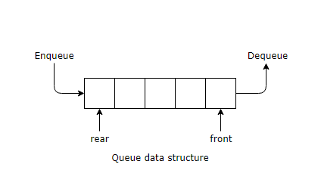
Representation of Data Structure Used in
Complain box

Slide 37
Code Description:
Code to store the complains of user
LinkedList is of string type so that user can write their complains. Queue is implemented to sort the complain which was in the data first.
Methods:
Enqueue – To add new complains
Dequeue – To delete resolved complains
isEmpty – To check whether the linkedlist is empty
Complain box

Slide 38
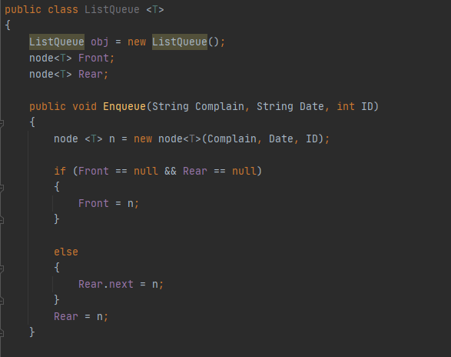
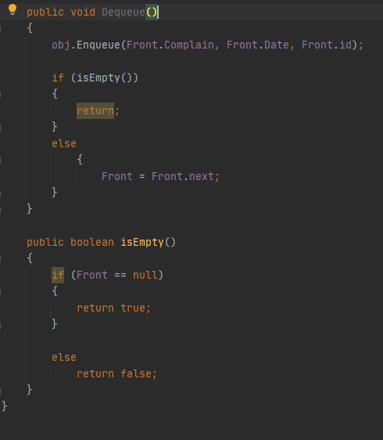

Slide 39
references
Data Structures – GeeksforGeeks
https://data.world/lpetrocelli/retail-banking-demo-data (for dataset)

Slide 40

Thank you
Any questions? Feel free to reach out:
u.asif.21749@khi.iba.edu.pk
s.anwar.22736@khi.iba.edu.pk
z.azam.22732@khi.iba.edu.pk

